Slide 1

SWIGGY RESTAURANT ANALYSIS USING SQL
BY SANDRA GANESHAN

Slide 2
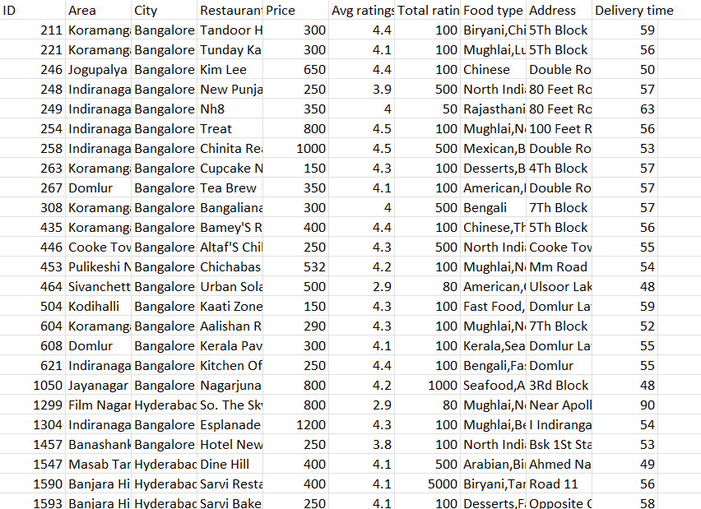
DATASET COLUMN OVERVIEW
ID
Area
City
Restaurant
Price
Average Ratings
Total Ratings
Food Type
Address
Delivery Time

Slide 3
PROBLEM STATEMENT
1.OBJECTIVE:
To analyze Swiggy restaurant data and gain insights into restaurant locations, customer ratings, food types, prices, and delivery times.
2.GOAL:
Identify trends and patterns in restaurant performance.
Analyze customer satisfaction based on ratings and reviews.
Assess operational efficiency through delivery times and pricing.
Provide insights for improving service quality.
3.OUTCOME:
Found key cities with high restaurant density and customer engagement.
Uncovered factors like delivery time and food type that significantly impact customer ratings.
Identified anomalies such as incorrect price entries and cities with slower delivery times, suggesting areas for improvement.

Slide 4
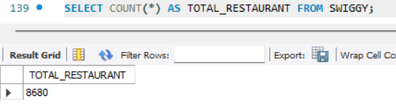
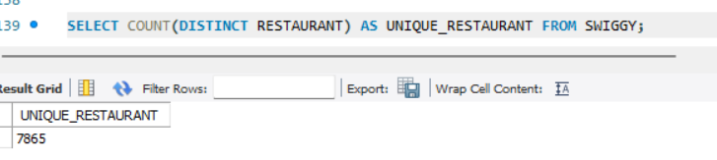
ANALYSIS
Q1. How many total restaurants are listed in the dataset?
Q2. How many unique restaurants are there in the dataset?

Slide 5
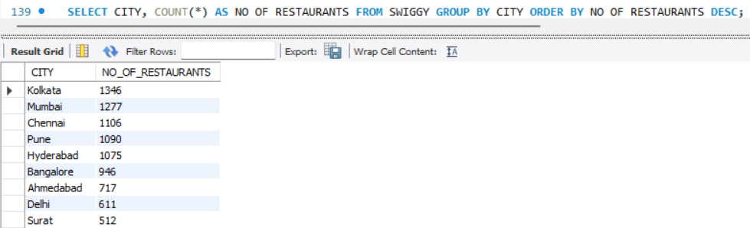
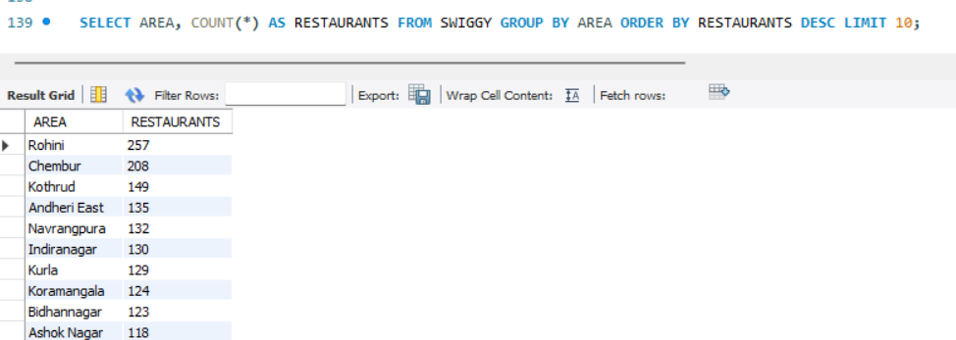
Q3.Which cities have the highest number of restaurants, and how are they distributed across cities?
Q4. What are the top 10 areas with the most restaurants?

Slide 6
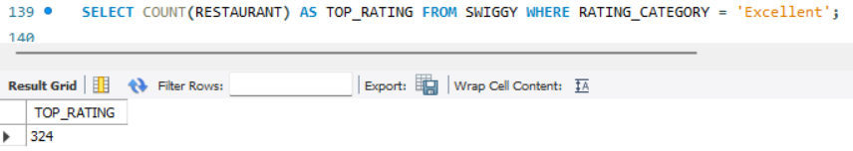
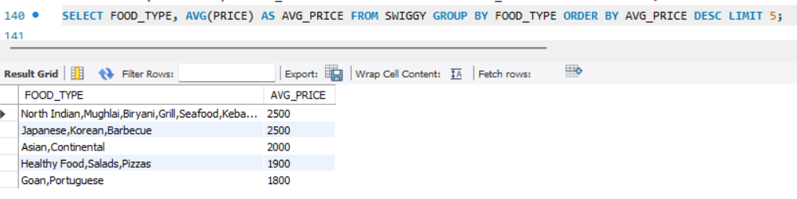
Q5. How many restaurants are rated as 'Excellent'?
Q6. What is the average price for different types of food, and which food types are the most expensive?

Slide 7
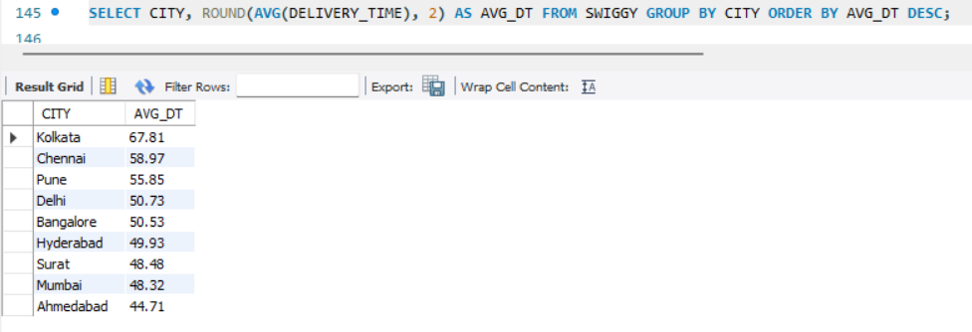
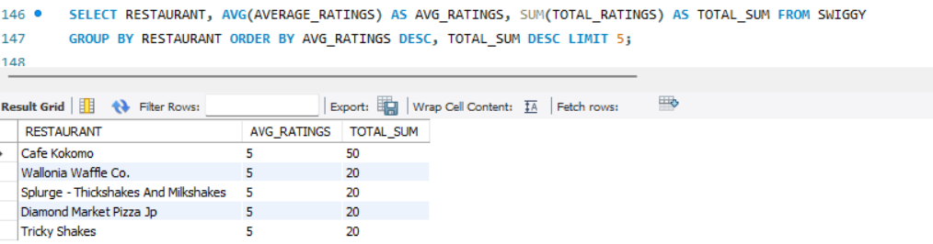
Q7. Which cities have the longest and shortest average delivery times?
Q8. Which restaurants have the highest ratings and the most total reviews?

Slide 8
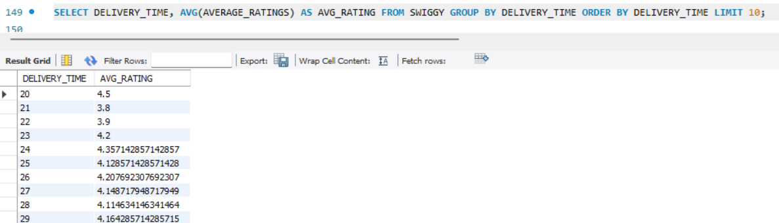
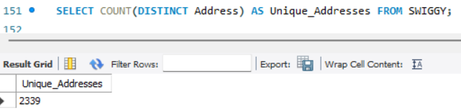
Q9. Is there a correlation between delivery time and customer ratings?
Q10. How many unique addresses are present in the dataset?

Slide 9
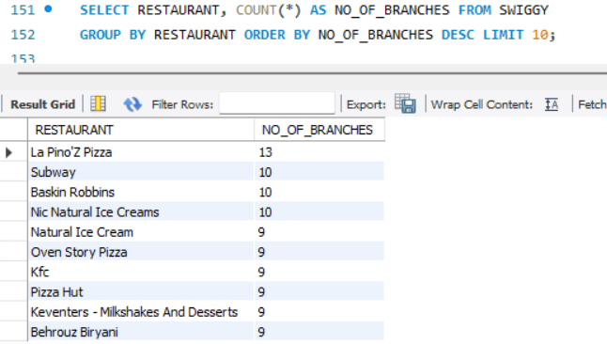
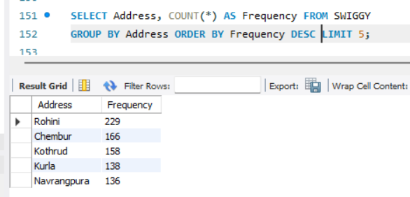
Q11.Which restaurants have the most branches across different cities, and how many branches do they have?
Q12. What are the top 5 most frequent addresses where multiple restaurants are located?

Slide 10
CONCLUSION
Majority of restaurants located in Hyderabad and Chennai.
High proportions of restaurants rated "Good" and "Excellent“.
Most restaurants deliver within 30-60 minutes; longer delivery times in some cities.
Higher ratings for premium food types like "Healthy Food" and "Japanese“.
Significant price variation across cities; Mumbai has the highest average price.
Outlier restaurants with high reviews but low ratings present improvement opportunities.
Data-driven insights can enhance restaurant selection, delivery efficiency, and pricing strategies.

